Slide 1
P
S
A
T
S
R
S
E
WN
OG
R
T
DH

Slide 2
P
S
A
T
S
R
S
E
WN
OG
R
T
DH

Slide 3

Password Armor: Secure Your Digital Life
Maintaining the security of our digital identities is crucial in today's interconnected world. Password Armor offers a comprehensive solution to safeguard your online presence and protect your valuable data from unauthorized access.

Slide 4

MOTIVATION
Passwords are the first line of defense against unauthorized access. Weak passwords can lead to security breaches, data loss, and even financial ruin. According to recent statistics, over 80% of hacking-related breaches are due to weak or stolen passwords.
.
INTORDUCTION
"Password strength validation is the process of evaluating the strength of a password to ensure it meets certain security criteria. This involves checking the password's length, complexity, and uniqueness to determine its strength.

Slide 5
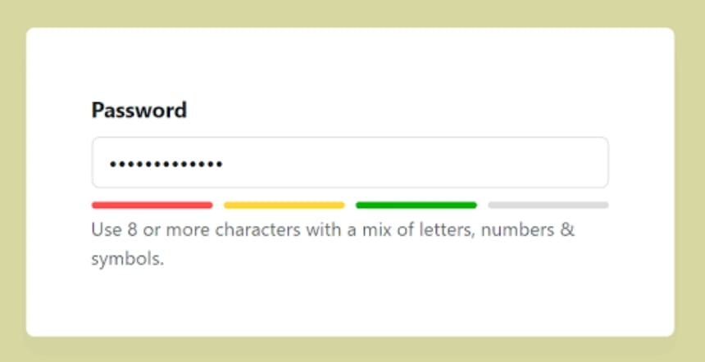
INTERFACE
how does password strength validation actually work? Well, there are a few different techniques that can be used. One common approach is to use a password strength meter, which checks the password against a set of predefined rules and provides a score based on how strong the password is.
The password must be at least 8 characters long.
The password must contain at least one uppercase letter.
The password must contain at least one lowercase letter.
The password must contain at least one number.
he password must contain at least one special character.
Here's an example of a password strength meter:

Slide 6
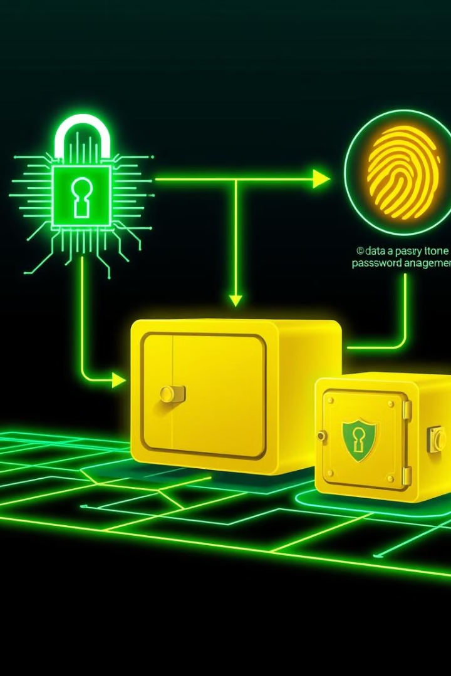
Methodology
1
Generate
Password Armor generates strong, unique passwords for all your accounts, eliminating the need for weak or reused passwords.
2
Store
Your passwords are encrypted and securely stored in the Password Armor vault, protected by advanced cryptographic techniques.
3
Authenticate
Access your passwords with biometric authentication, such as fingerprint or facial recognition, for an added layer of security.

Slide 7




Workflow
Add Accounts
Easily add new login credentials and personal information to your Password Armor vault.
Autofill Login
Password Armor seamlessly autofills your login forms, saving you time and eliminating the risk of manual input errors.
Cross-Device Sync
Your password vault is synchronized across all your devices, ensuring you have access to your credentials wherever you go.

Slide 8

Code Understanding
1
Secure Storage
2
Seamless Integration
Password Armor's codebase utilizes robust encryption algorithms to protect your data, ensuring your passwords remain confidential.
The application seamlessly integrates with your device's operating system and popular web browsers for a seamless user experience.0
3
Automated Workflows
Password Armor's code streamlines password management tasks, such as generation, autofill, and synchronization, saving you time and effort.

Slide 9
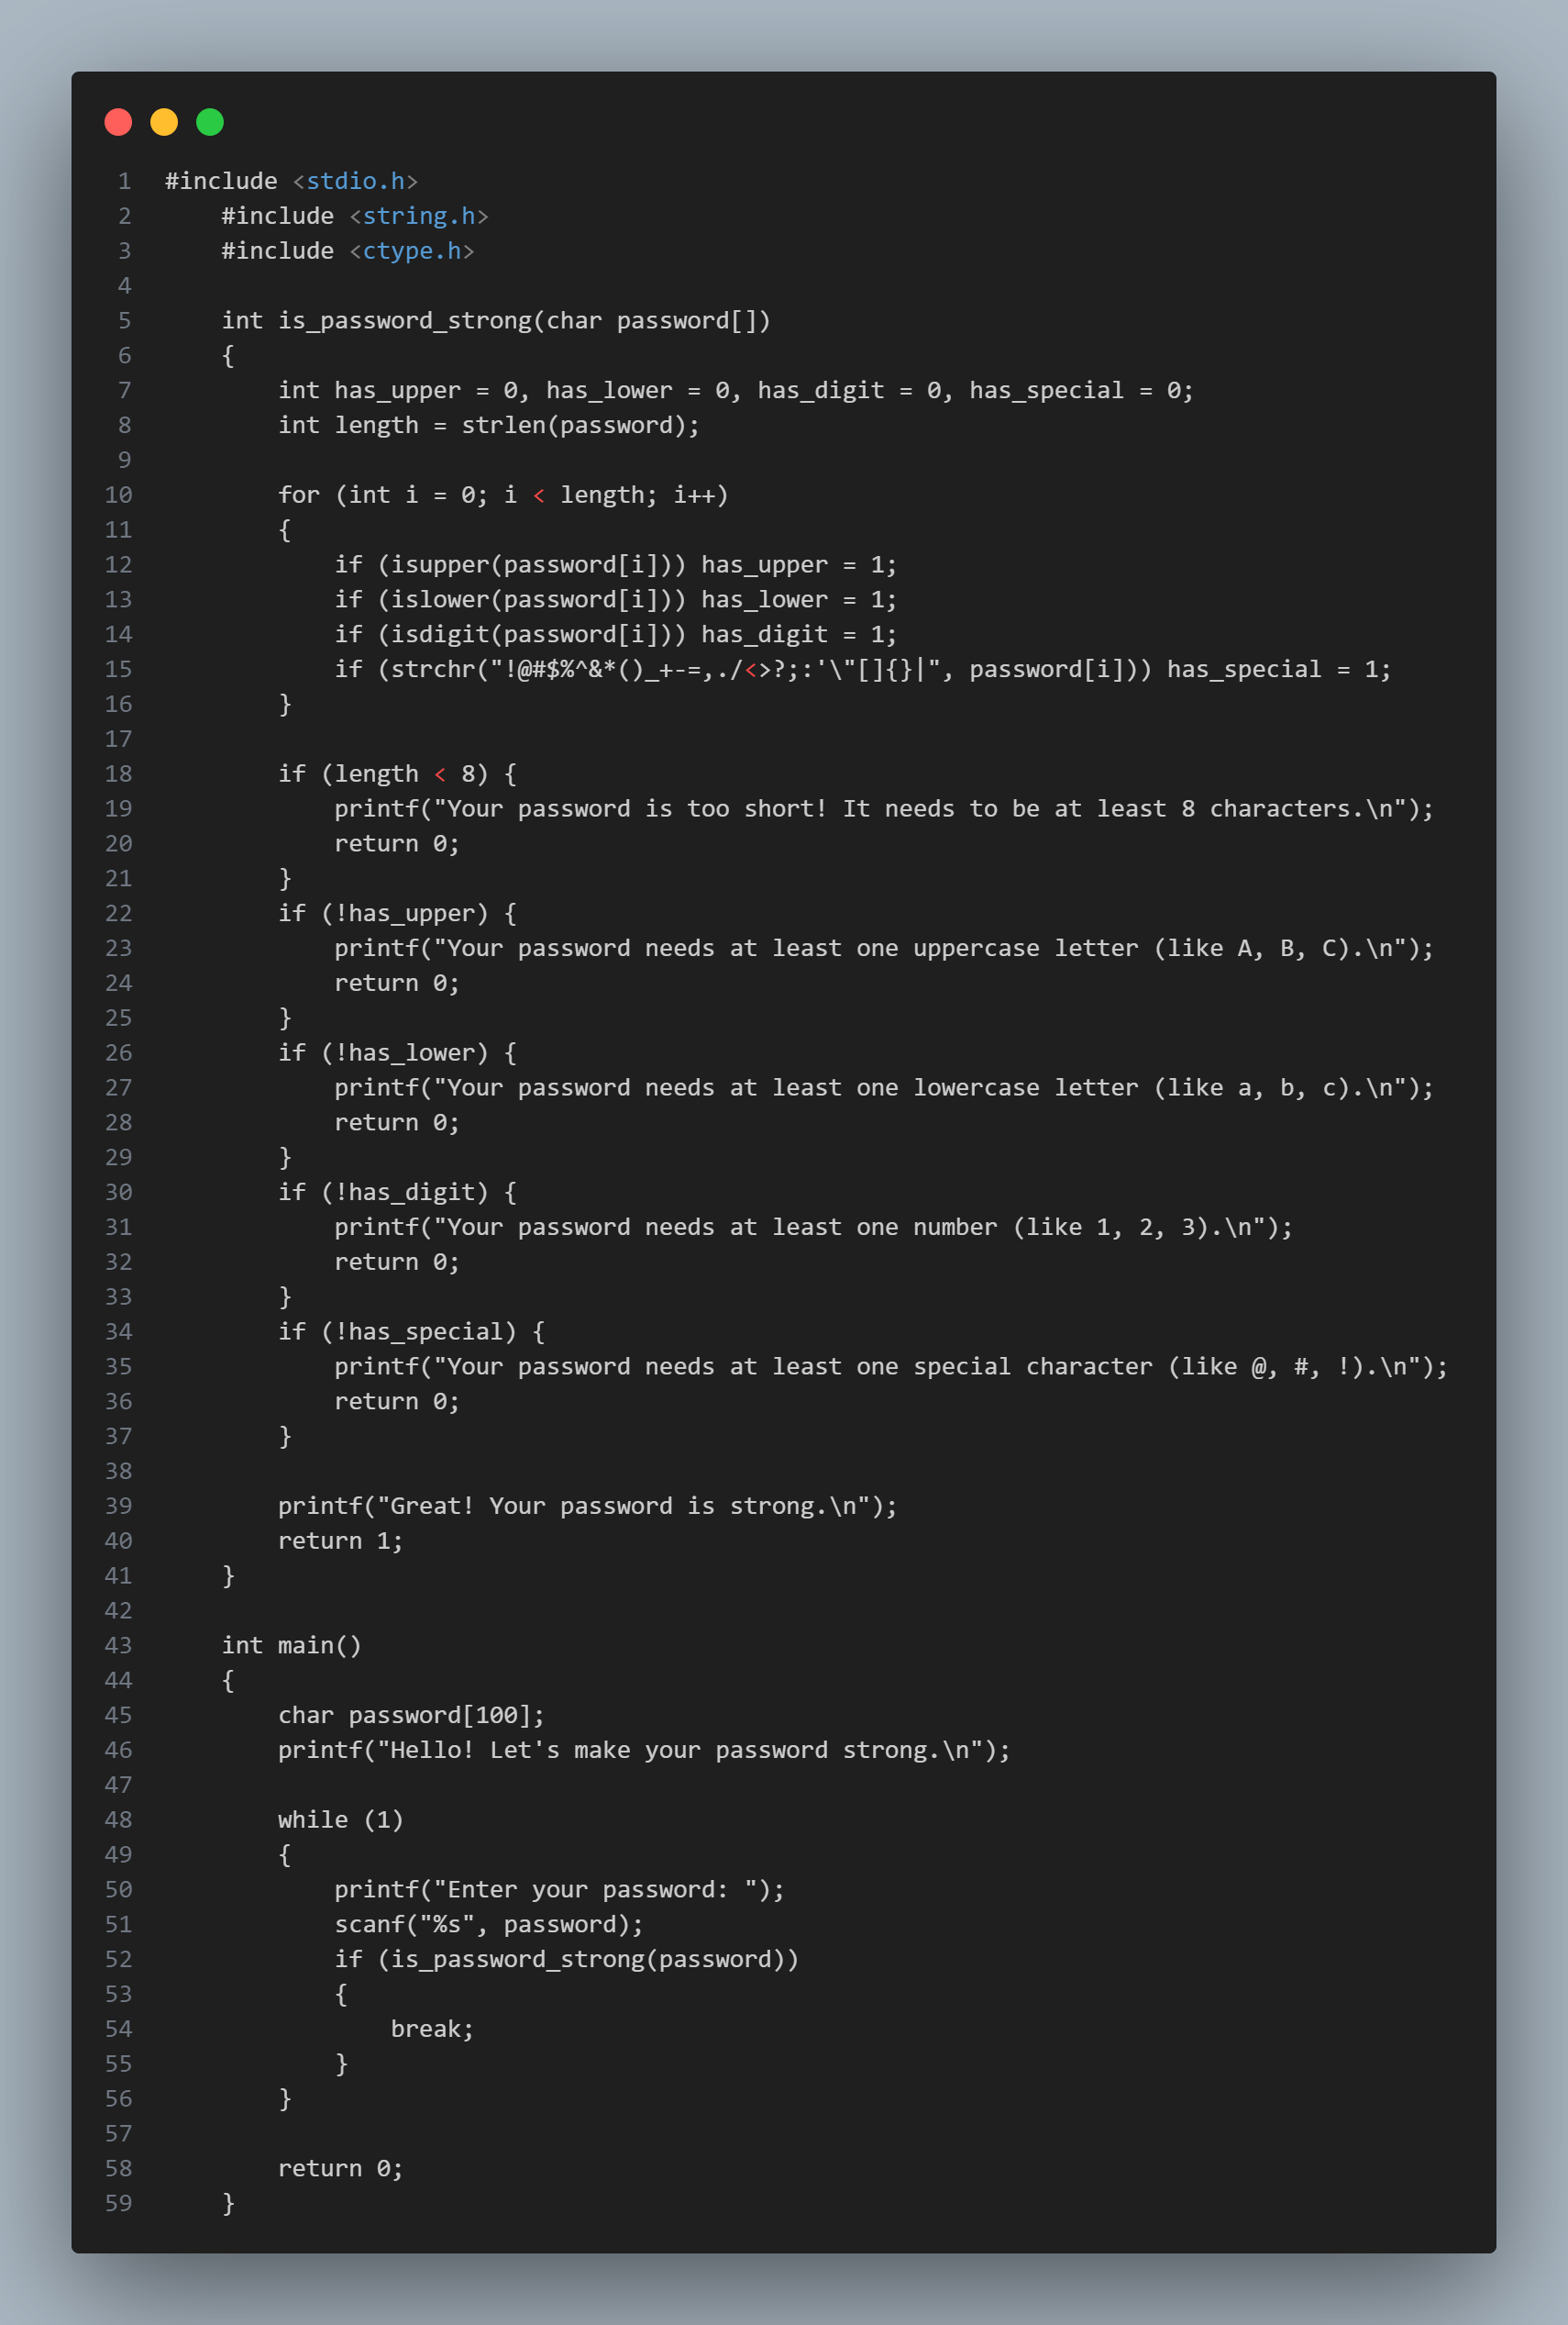
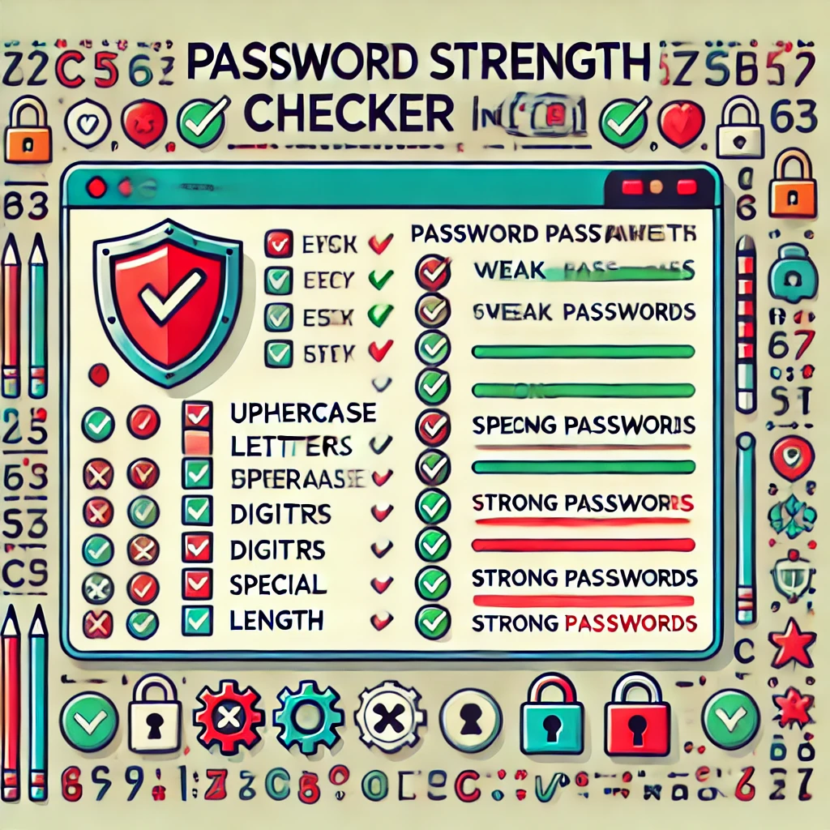
Here's a visual representation of your password strength checker program. It highlights the criteria for a strong password, such as length, uppercase and lowercase letters, digits, and special characters, along with C code context. Let me know if you'd like further adjustments!

Slide 10

Conclusion
Password Armor is a comprehensive solution that safeguards your digital life by providing robust password management, advanced encryption, and seamless integration across all your devices. Embrace the power of Password Armor and take control of your online security.

